Slide 1
Vehicle Class
Madt Peck, UW Alum madt.squinge@gmail.com
27 September 2013

Slide 2
Vehicle Class: Functions
Want to define a class of vehicles that can be applied to multiple simulations (keep it simple)
Function takes inputs and creates an object with specified properties
Additional command to advance the object according to inputs:
Heading angle, Climbing angle, Speed, Time increment

Slide 3
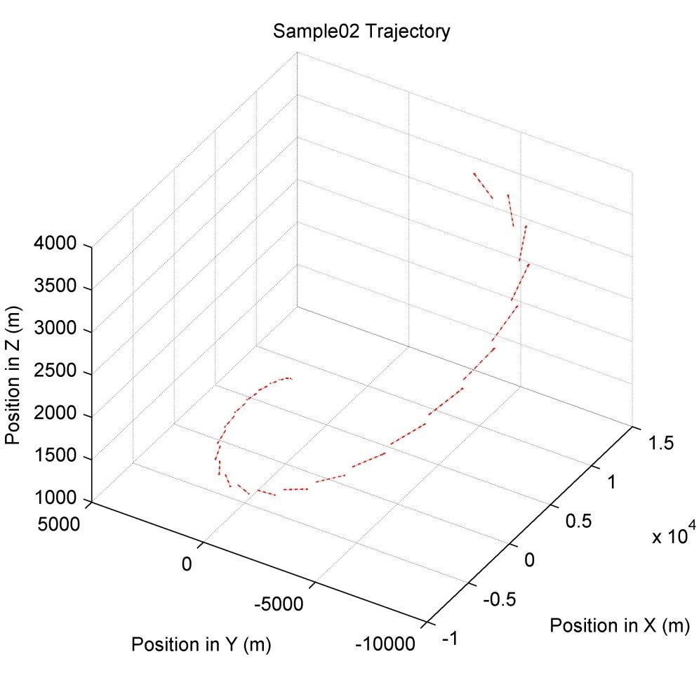
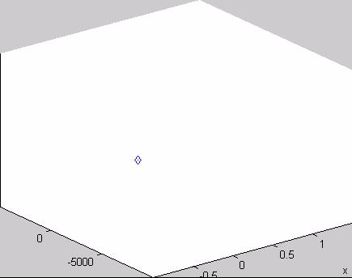
Vehicle Class: Test
Test each section of the code
Sample02 Motion
Fig 1: Motion of test vehicle over 100 seconds
Fig 2: Sample trajectory for test vehicle over 100 seconds

